Slide 1

ODAS : Object Detection and Alert System
(To Prevent Train Derailment)
Rohit Soni
1NT23EE044
Rounak Vyas
1NT23EE045
IoT And Smart Cities
Nitte Meenakshi Institute of Technology (Bengaluru)

Slide 2
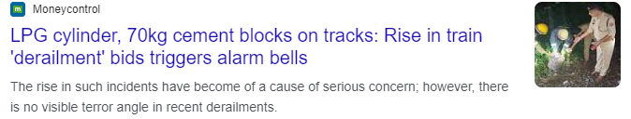
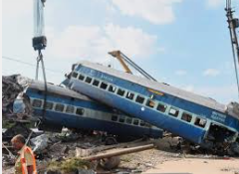
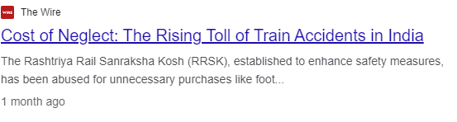
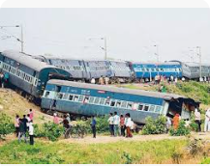
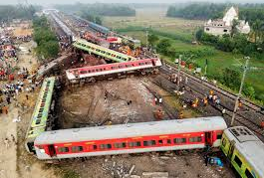
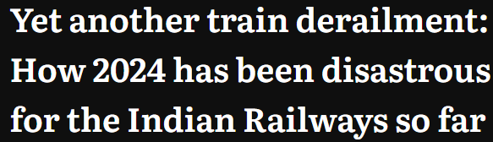
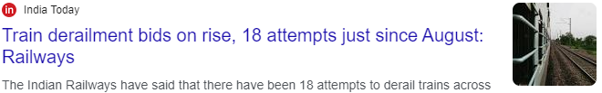
The Problem – Train Derailments Due to Objects on Tracks
Derailments pose a critical safety threat to India’s rail network, with an average of 40 derailments per year due to foreign object interference. This is compounded by aging infrastructure, increased cargo traffic, and urban encroachment.
Current problem: Track-based obstructions, including fallen trees, rocks, animals, or human intervention, result in derailments, leading to loss of life, delays, and significant damage to the railways' reputation and finances.
Recent Statistics: In this year alone, derailments due to object collisions accounted for over ₹500 crore in damages, and several loss of lives and injuries.
As trains continue to increase in speed and frequency, the existing methods of object detection are no longer sufficient.

Slide 3
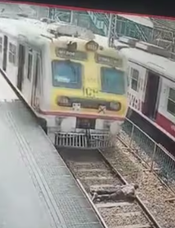
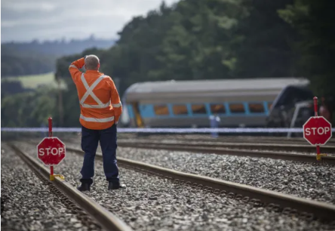
Existing Solutions – Why They Are Insufficient
Indian Railways currently employs trackside monitoring systems and manual visual inspection methods, which are outdated and plagued by human error and inefficiency.
Mechanical sensors, which detect disruptions along the track, are highly prone to false positives from harmless objects like leaves or small twigs, causing unnecessary slowdowns and delays.
Camera-based systems, while useful in some scenarios, suffer from limitations in bad weather conditions, such as fog, heavy rain, and night-time operations. They also require constant human monitoring and have delayed response times when detecting fast-moving trains.
These solutions do not offer real-time predictive capabilities, meaning obstacles are identified too late for preventive action to be taken, especially with high-speed trains.

Slide 4
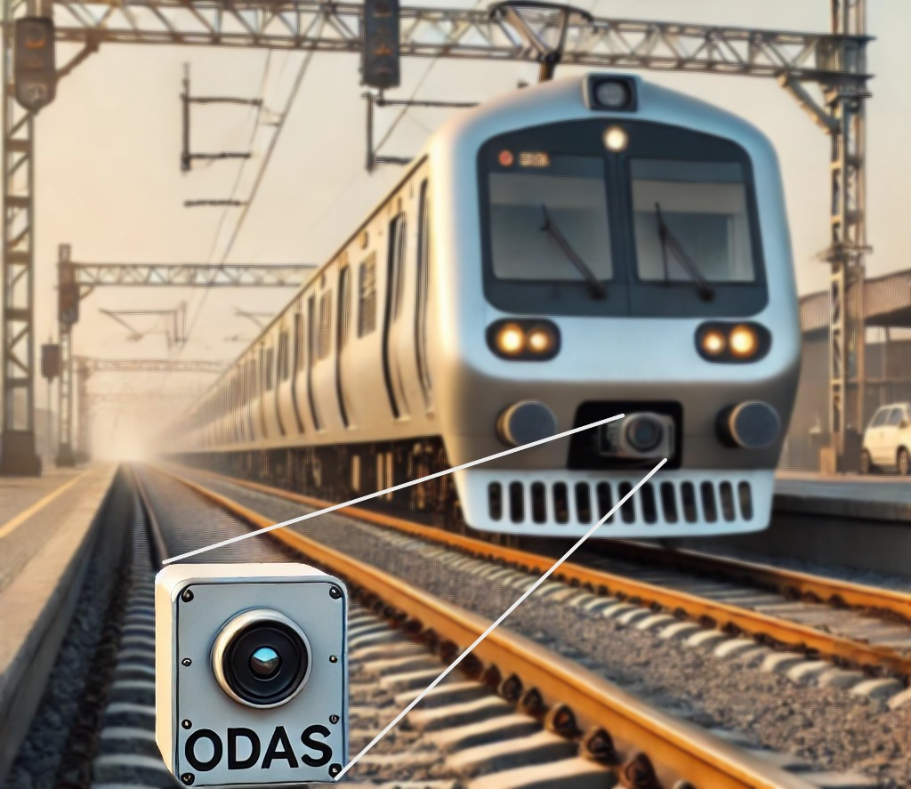
Introducing ODAS – Our IoT-Based Solution
ODAS combines IoT technology, sensor fusion, and machine learning algorithms to provide a comprehensive, real-time obstacle detection system. Designed to mitigate the increasing risk of derailments, it detects obstacles well in advance and differentiates between harmless objects and dangerous obstacles.
ODAS incorporates LIDAR, radar, and infrared sensors, along with advanced image processing to assess the object’s size, distance, and material properties. This ensures accurate detection while minimizing false alarms.
Development Process: We have approached the problem by focusing on multimodal sensor integration, testing each sensor under varying environmental conditions, and refining the object classification system.
AI-enabled Object Detection: ODAS employs neural network algorithms to learn and improve its detection capabilities over time, ensuring that the system can accurately differentiate between lethal and non-lethal objects, such as small debris.

Slide 5
How ODAS Works and Why It’s a Superior Solution
Real-time, 360-degree Scanning: ODAS continuously scans the tracks in front of the train, using laser-based LIDAR technology to create a precise 3D map of the area ahead, identifying objects up to 1 kilometer away even if the train is moving with a significantly high speed.
Multi-Sensor Fusion: The combination of LIDAR, radar, and infrared allows ODAS to function in all weather conditions, including fog, rain, and night. This ensures reliable detection regardless of environmental challenges.
Instant Threat Analysis: Once an object is detected, ODAS employs machine learning models to instantly assess whether the object poses a threat. Factors such as object velocity, material density, and distance to impact are calculated to determine if braking or evasive action is required.
Long-term Solution: Traditional mechanical sensors have high maintenance costs due to wear and tear, whereas ODAS, as a software-driven system with cloud-based data processing, reduces operational costs.
Satellite Integration: A satellite system performs periodic scans of the railway tracks to detect lethal obstacles. If a potential threat is identified, it alerts all the substation and trains passing through the same track, including the nearest train to the detected object. This alert system enables timely maneuvers of train controls and enhances coordination with ODAS, allowing for proactive safety measures and reducing the risk of derailment.
.

Slide 6
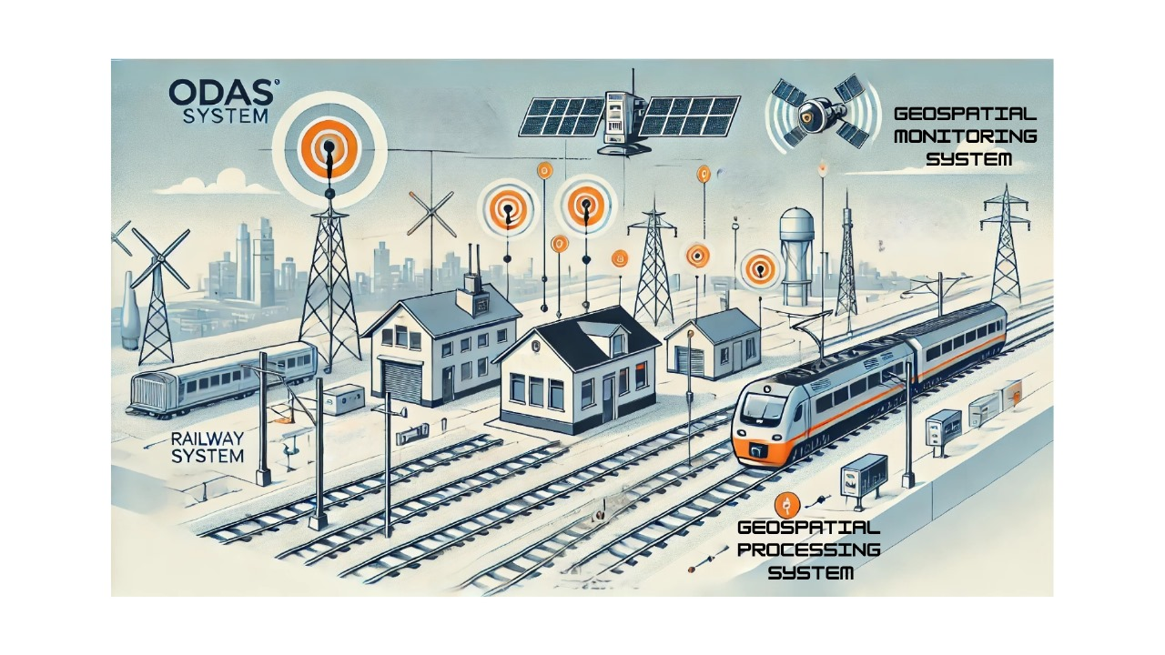
ODAS VISUAL REPRESENTATION

Slide 7
The Advantages of ODAS (Technical Superiority)
Data Collection and Analysis: The system can gather valuable data on track conditions and obstacle occurrences, helping railway authorities to improve maintenance schedules and operational protocols.
Adaptable to Different Train Types: ODAS can be implemented on high-speed trains, passenger trains, and freight trains.
Weather-Proof Technology: Unlike traditional systems, ODAS operates flawlessly in all weather conditions, including extreme heat, dense fog, and heavy rains, ensuring 24/7 protection.
Scalable and Modular Design: ODAS is designed with a modular architecture, meaning that as new sensor technology becomes available, upgrades can be seamlessly integrated into the system without the need for large-scale infrastructure overhauls.
Fewer False Positives: The use of AI ensures that only genuinely dangerous objects trigger alerts or braking, keeping trains running efficiently and reducing unnecessary stops.

Slide 8
Overview And Details
ODAS (Obstacle Detection and Avoidance System) will enable a moving train,(of speed up to 100 km/h ), to detect obstacles ahead within a specified range. By utilizing advanced algorithms, the system will assess the situation and make real-time decisions, allowing the train and locopilot to make a decision from the listed possible options.
Continue safely at speed
Gradually reduce its speed to minimize collision impact
Activate emergency braking to prevent potential collisions.
AI Algorithms in ODAS:
Object Detection: Convolutional Neural Networks (CNNs) classify and localize obstacles in real-time.
Classification Model: Random Forest evaluates detected obstacles to assess threat levels.
Decision Algorithm: Bayesian Networks determine emergency braking actions based on sensor data.
Weather-Adaptive Sensing: The system adjusts sensitivity according to environmental conditions for accurate detection.
Failure Detection: Anomaly detection ensures continuous monitoring of sensor functionality for optimal safety.

Slide 9


Profile:
Name: Rohit Soni
USN: 1NT23EE044
College: Nitte Meenakshi Institute Of
Technology,Bengaluru
Email: 1nt23ee044.rohit@nmit.ac.in
Phone: 6354959448
Name: Rounak Vyas
USN: 1NT23EE045
College: Nitte Meenakshi Institute Of Technology,Bengaluru
Email: 1nt23ee045.rounak@nmit.ac.in
Phone: 8005863350

Slide 10
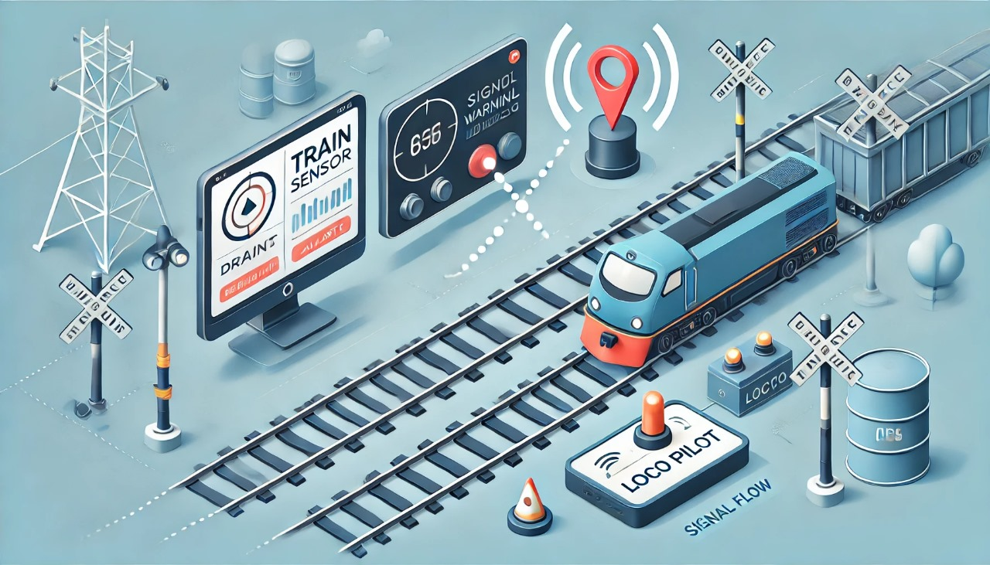
THANKYOU

